Slide 1
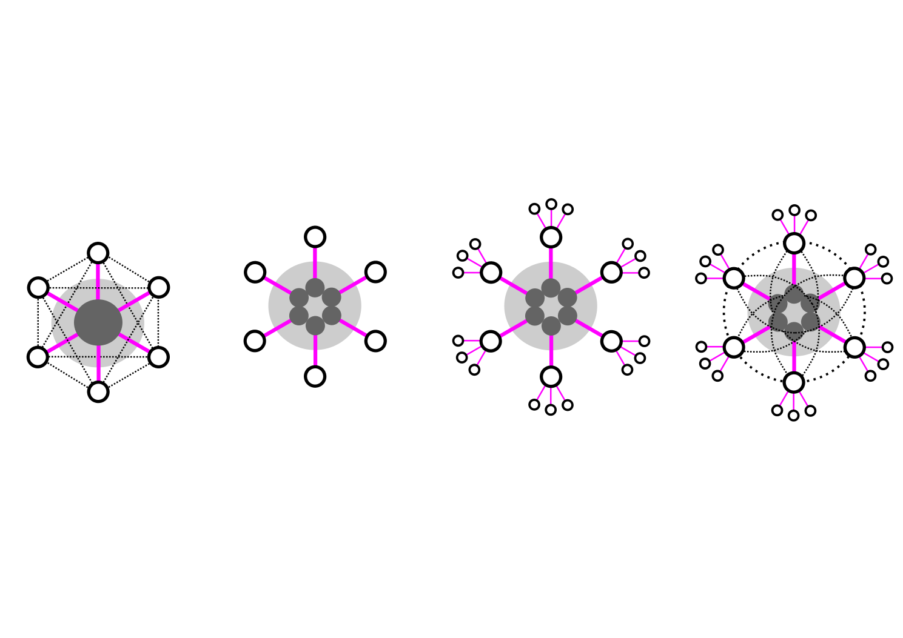
“The future is already here — it's just not very evenly distributed"
William Gibson
c1993

Slide 2
[technological processes]
“...the term de-materialised does not necessarily mean “without material” but may, instead, refer to modes of materialization that render infrastructures imperceptible or ephemeral."
Jennifer Gabrys
Digital Rubbish

Slide 3
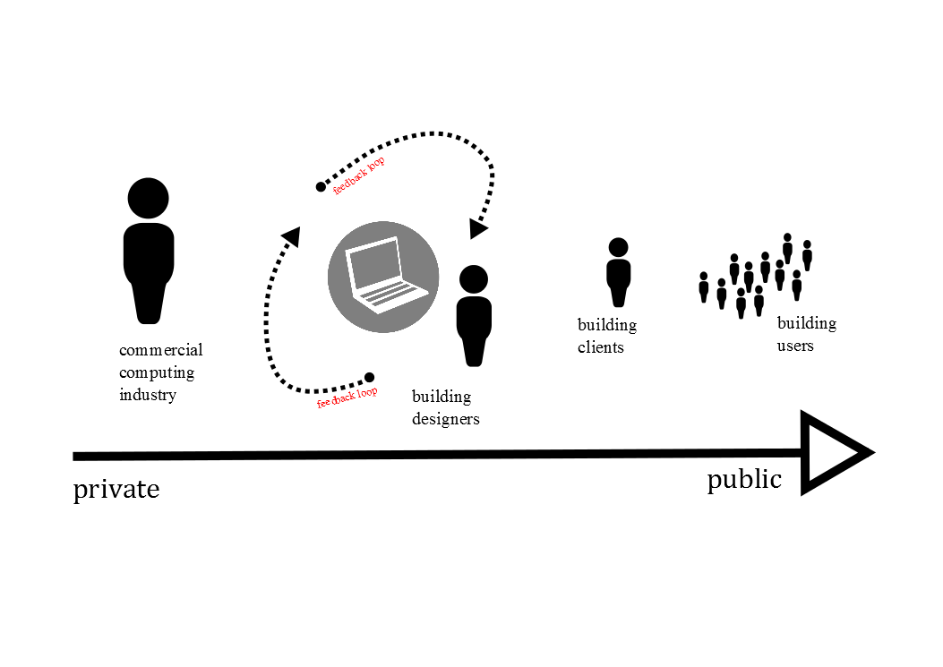
[relationships to building design technology]

Slide 4
[technological processes]
“Facts are theory-laden,
theories are value-laden,
values are history-laden."
Donna Harway
Simians, Cyborgs, Women

Slide 5
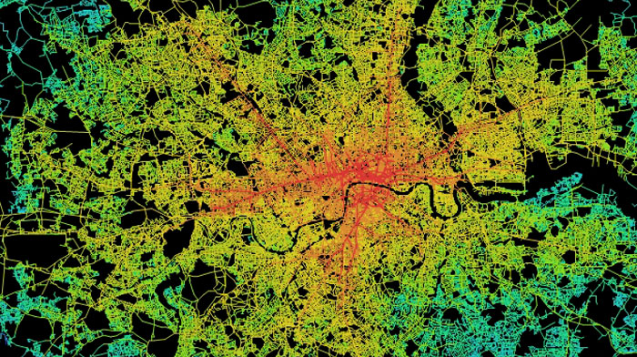
[simulation]
“Such models may be flawed then as they take the simplified abstraction of the complexity of the world and return it as it's underlying structure...”
Katheryn Hayles
How We Became Post Human:
Virtual Bodies in Cybernetics, Literature and InformaticsC

Slide 6
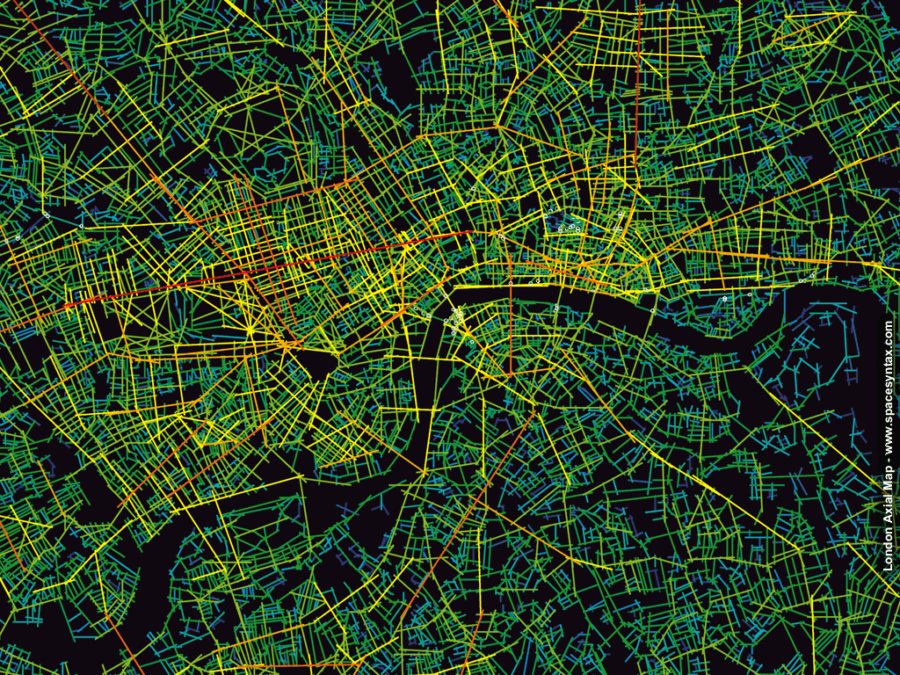

Slide 7
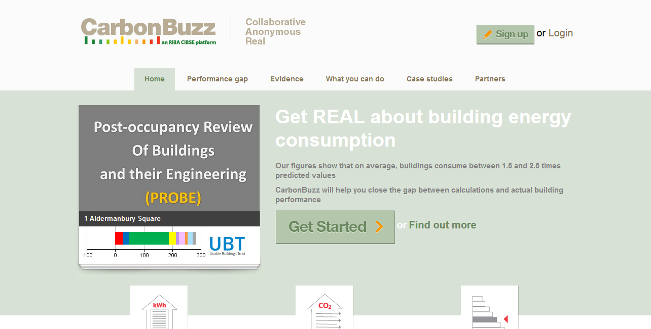

Slide 8
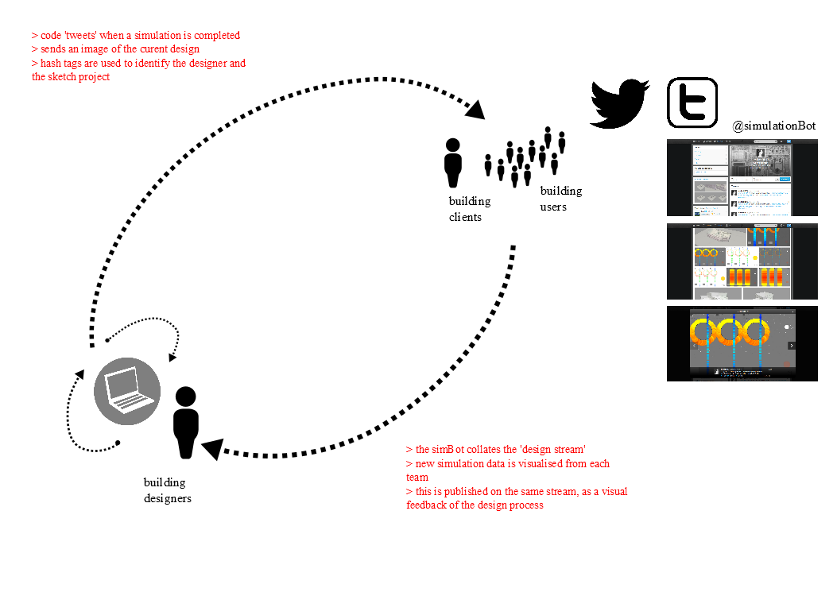
[alternative relationships??]
@simulationBot

Slide 9
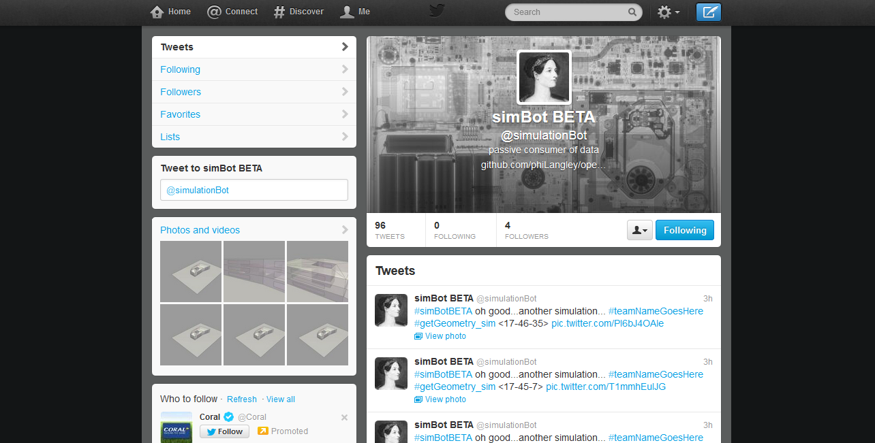

Slide 10
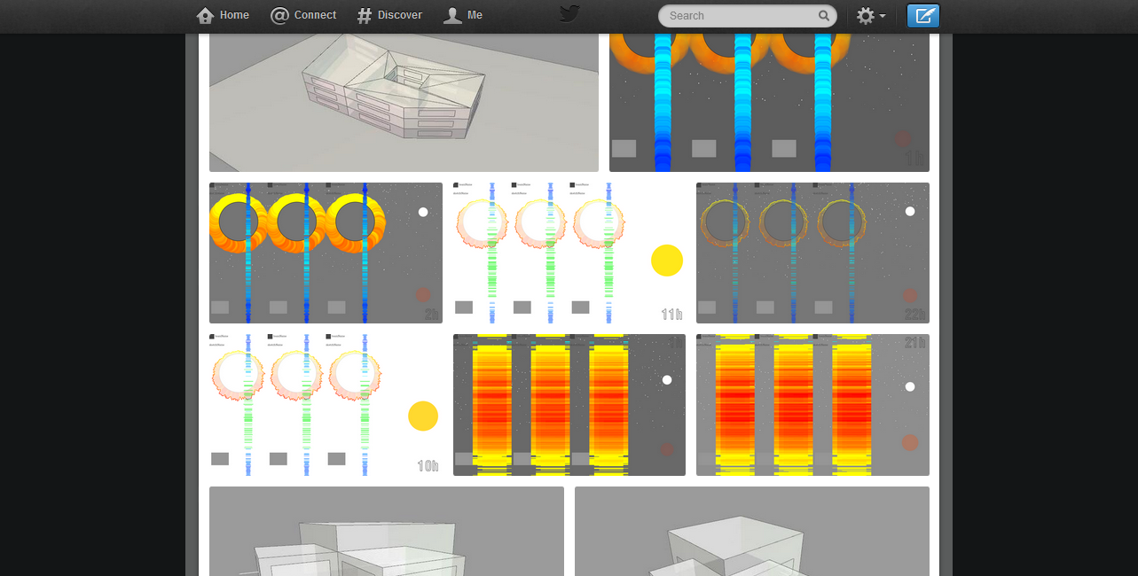

Slide 11
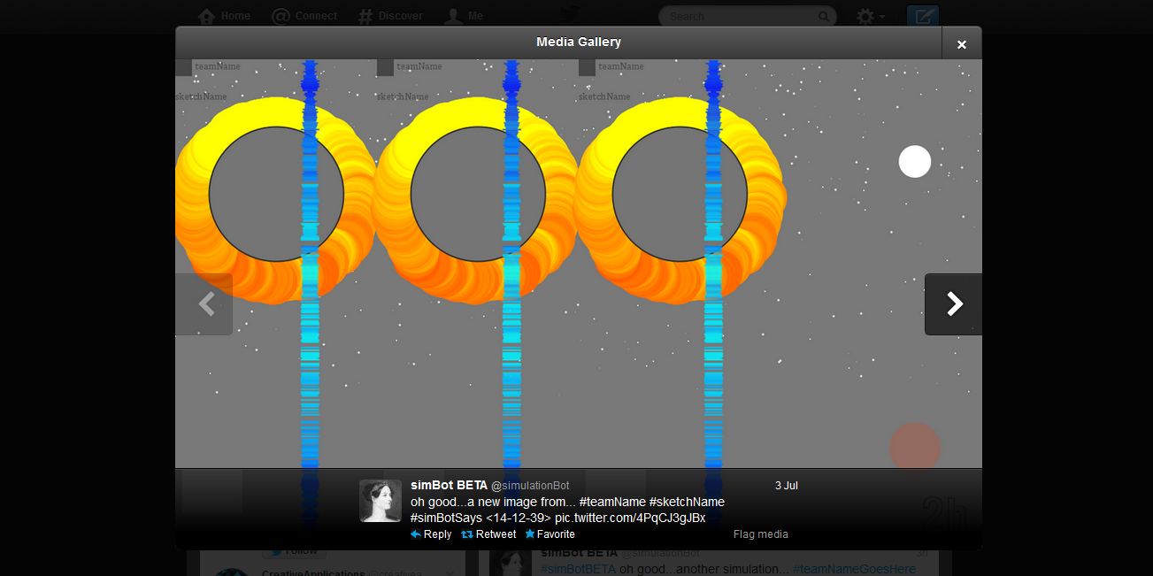

Slide 12
[ simulation]
“As with any model, there is a trade-off here; we exchange the complexity of the object's change of state for the complexity of the modelling space. In other words, an objects instantaneous state, no matter how complex, becomes a single point, a great simplification, but the space in which the object is embedded becomes more complex.”
Manuel DeLanda
Intensive Science and Virtual Philosophy

Slide 13
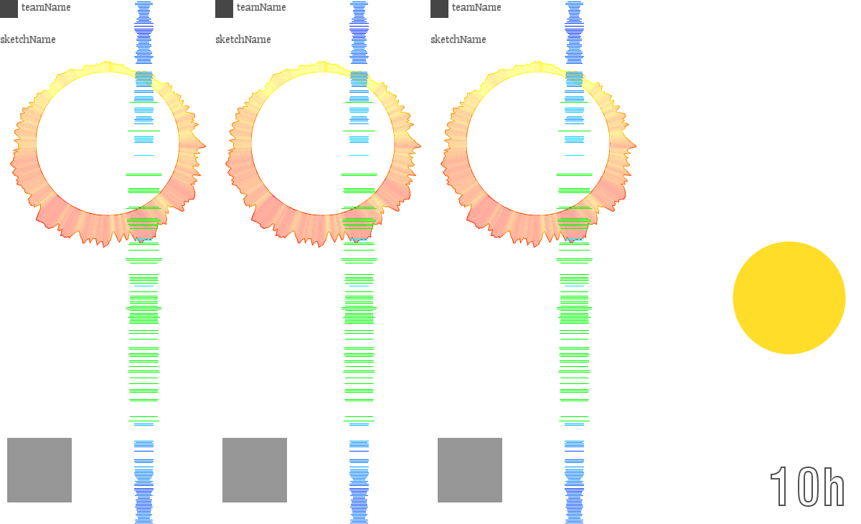

Slide 14
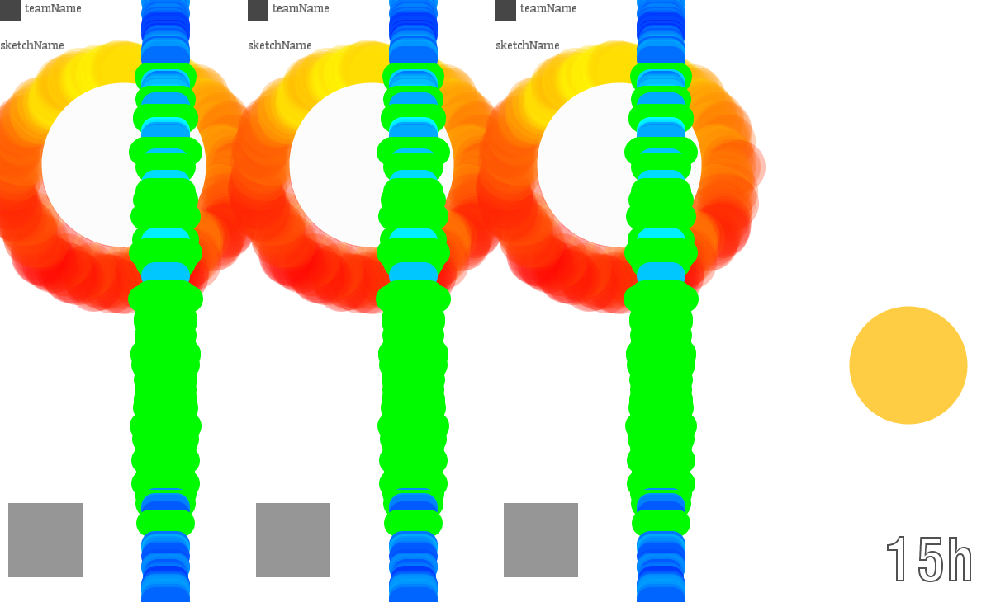

Slide 15
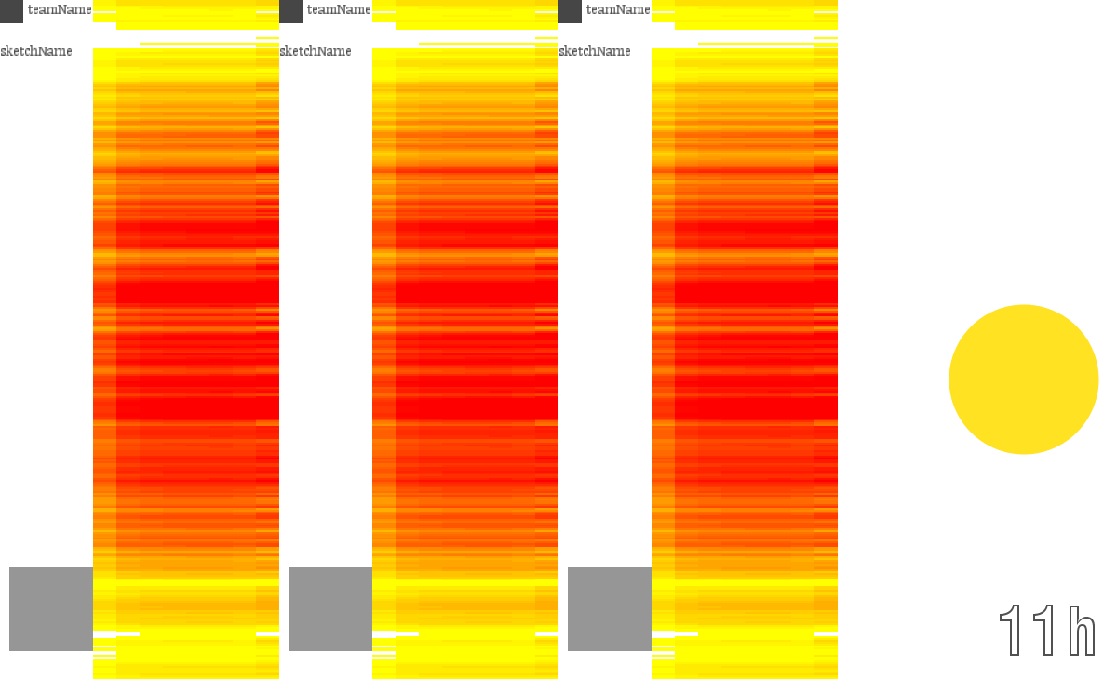

Slide 16
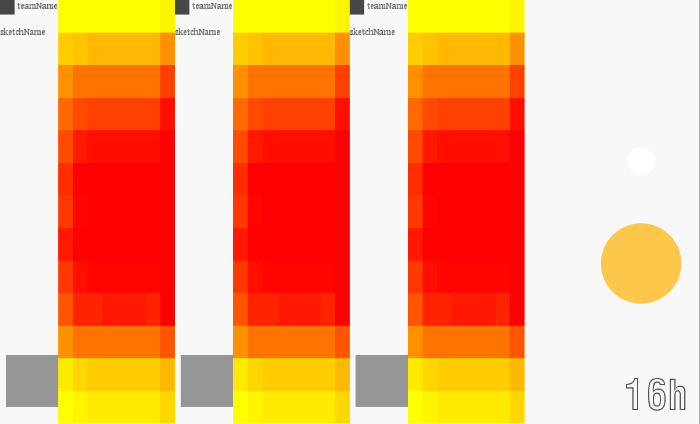

Slide 17
@simulationBot

